Slide 1
Best Buy Product Price
Pratyush Nayak

Slide 2
Best Buy
Best Buy is an American multinational consumer electronics retailer, founded by Richard M. Schulze and Gary Smoliak as an audio specialty store in 1966, Best Buy has become one of the biggest consumer electronics retailers in the world. It, sells both products and services through three primary channels: retail stores, online, and call centers.

Slide 3
Best Buy API
Best Buy's easy-to-use catalog of APIs gives users access to a wide range of data across the history of BestBuy.com, including product, store, category and more.
The Best Buy Products API provides a simple, REST-based interface for our entire product catalog, past and present. This includes pricing, availability, specifications, descriptions, and images for more than one million current and historical products.
API
Curl=‘https://api.bestbuy.com/v1/products(longDescription=iPhone*|sku=7619002)?show=sku,name&pageSize=15&page=5&apiKey=YourAPIKey&format=json'

Slide 4
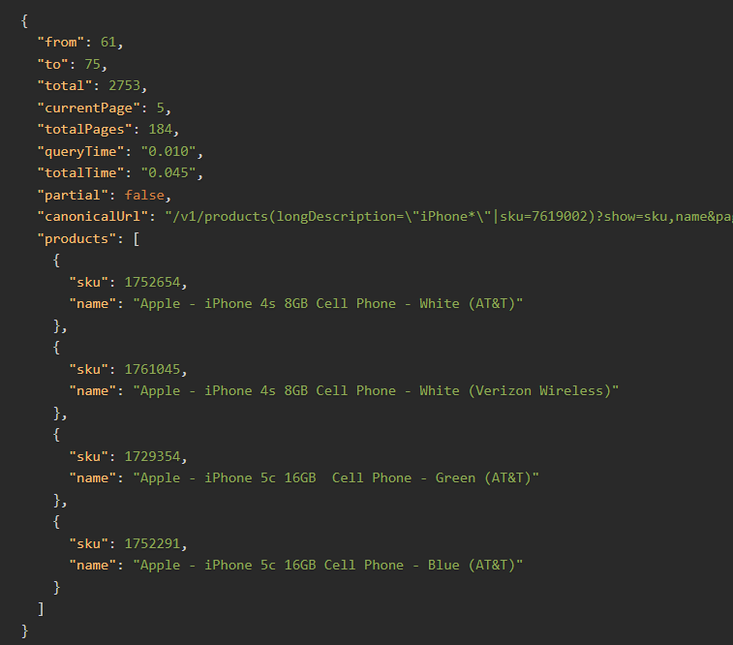
Dataset
The Dataset is created using Best Buy API, especially the Product API of is used to find the products features. After using the API’s, we receive the data in a JSON format which is kind of NoSQL format of data. We will get data in this manner:

Slide 5
Dataset
As we saw that our JSON data have multiple pages, with each page have specific number of product info we need to extract all the products info from each pages one by one.
Also, while using the Best Buy APIs, we restricted ourself with products which are came after 2014 till February of 2022. Additionally, we also take the only those product on which had more than 100 customer rating counts.

Slide 6
Dataset
We also try specify the attributes which we think give us better prediction about the price of the product.
So here we took Features like:
Name: Product name
Condition: Identifies if the product is new, refurbished or pre-owned
Online Availability: Identifies if a product can be purchased online

Slide 7
Dataset

